Slide 1
Hospital Management Insights through Data Analysis
Turning hospital data into actionable insights for better decision-making

Slide 2
Explore the Data using Excel. understand the data and prepare a short summary about the dataset.
Appointments Sheet: Logs patient appointments with details such as appointment ID, patient ID, doctor ID, appointment date, visit reason (e.g., therapy, checkup, consultation), appointment status (Scheduled, Completed, Cancelled, No-show), and a no-show indicator.
Patients Sheet: Stores patient demographic information including patient ID, full name, age, gender, address, registration date, and insurance provider.
Doctors Sheet: Contains doctor profiles with doctor ID, full name, specialization (e.g., Dermatology, Pediatrics, Oncology), years of experience, and hospital branch.
Treatments Sheet: Tracks treatments linked to appointments, with fields such as treatment ID, appointment ID, treatment type (e.g., Chemotherapy, MRI, X-Ray), description, cost, and treatment date.
Billing Sheet: Manages billing records, including bill ID, patient ID, treatment ID, bill date, amount, payment method (Insurance, Cash, Credit Card), payment status (Paid, Pending, Failed), and completion status.
👉 Collectively, this dataset provides a holistic perspective of hospital activities, encompassing patient demographics, doctor details, appointment histories, treatment records, and billing transactions. It can be leveraged for healthcare analytics, including insights into appointment trends, patient demographics, doctor workloads, treatment costs, billing and payment behaviors, as well as no-show patterns.

Slide 3
Perform Data cleaning if required and then do Statistical Analysis on data using statistical tools.
This project focuses on analyzing hospital operations using datasets related to patients, doctors, appointments, treatments, and billing. Data preparation involved cleaning by removing redundant columns (such as contact details and appointment time) and standardizing name fields into a single Full Name column. Additionally, treatment costs were rounded to whole numbers for consistency. The refined dataset enables valuable insights into appointment patterns, treatment expenses, doctor performance, and billing/payment trends, supporting informed decision-making and enhancing healthcare efficiency.

Slide 4
Insert the given data into the SQL server by making a Database and defining the required parameters for the construction of Database and Database tables.

Slide 5
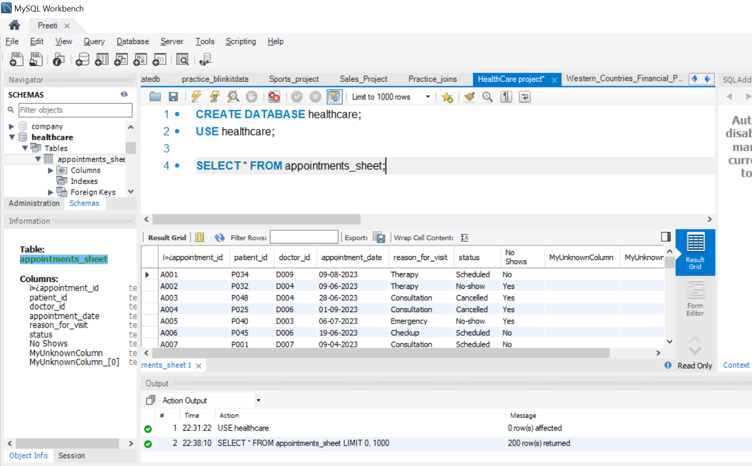

Slide 6
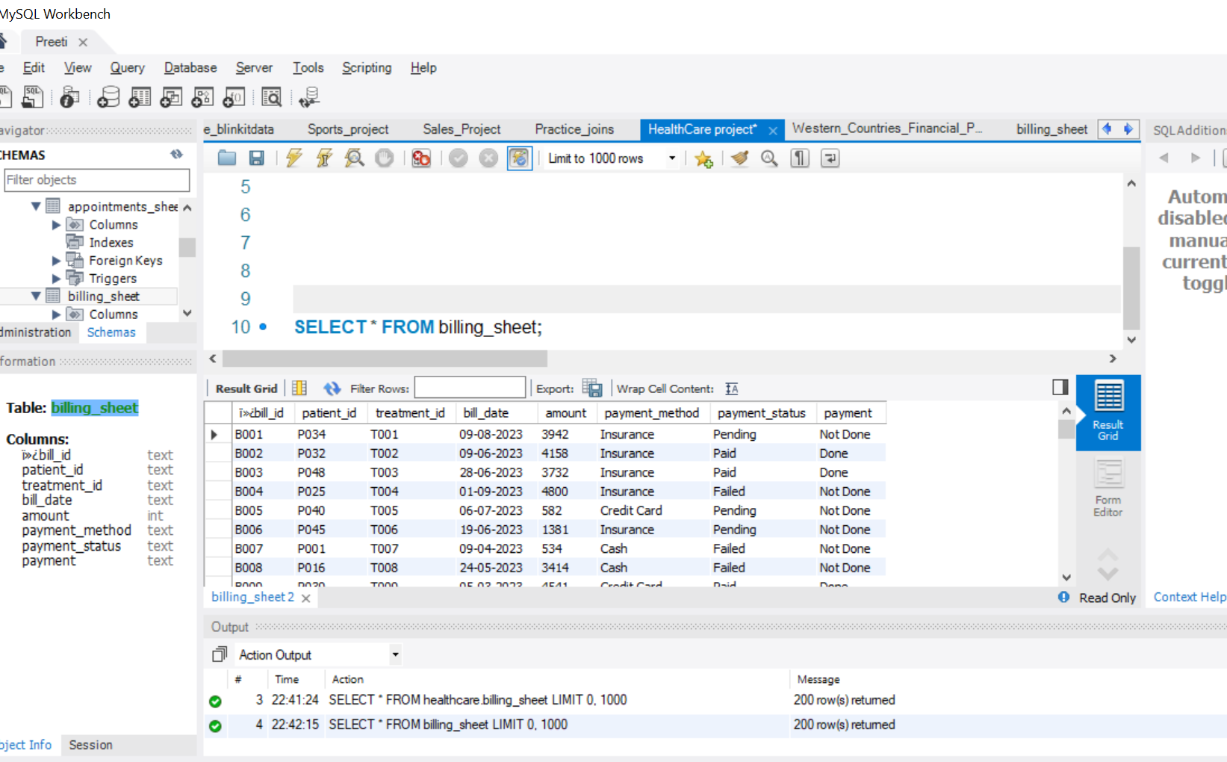

Slide 7
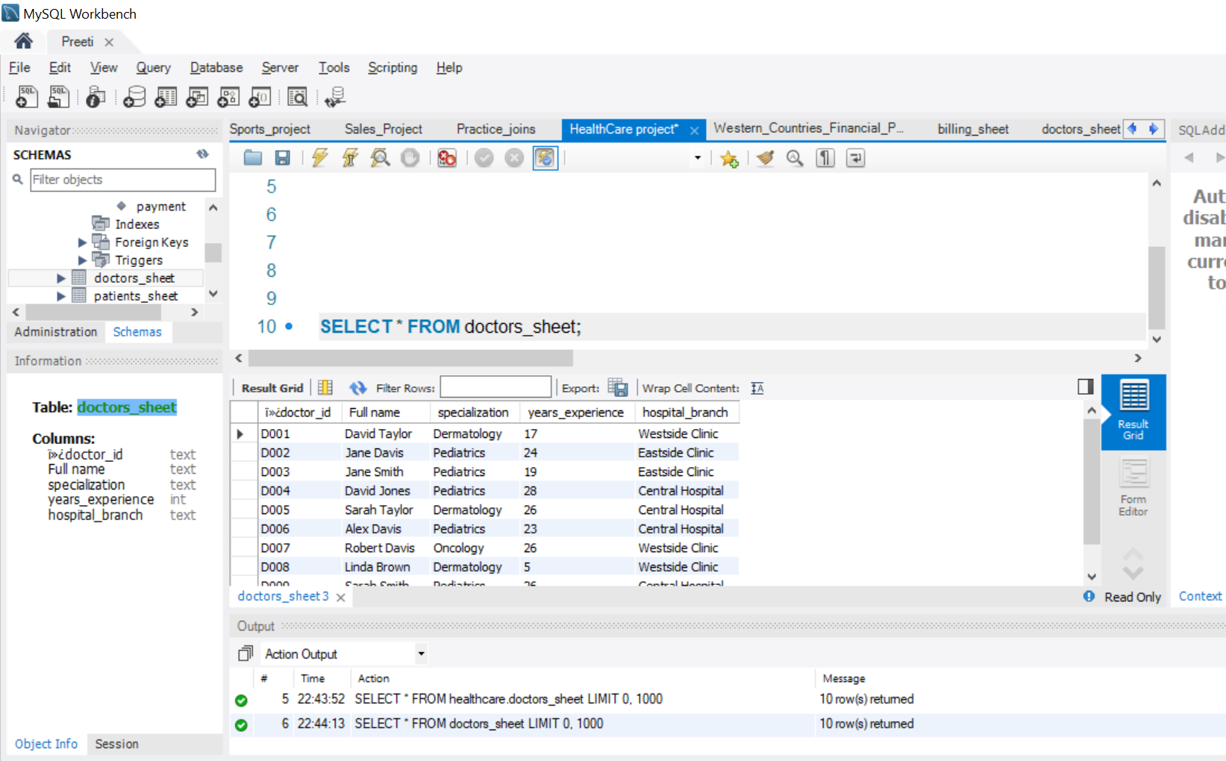

Slide 8
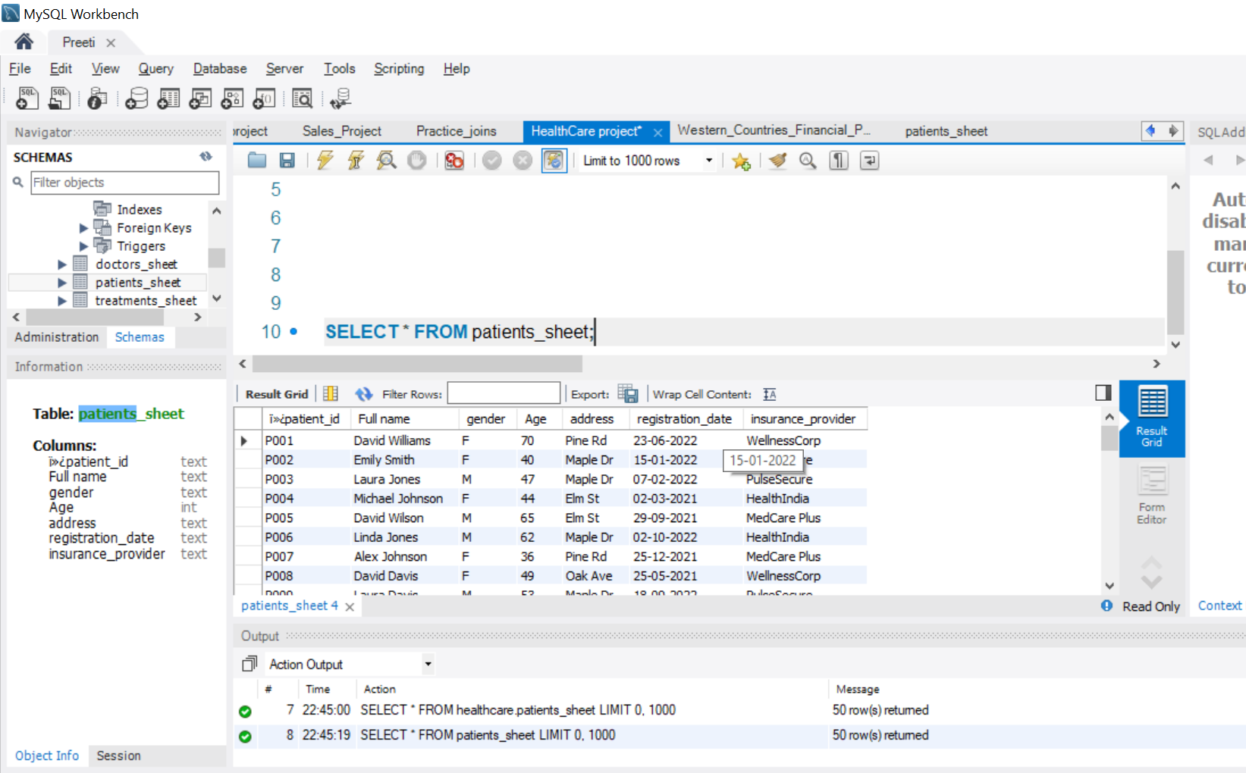

Slide 9
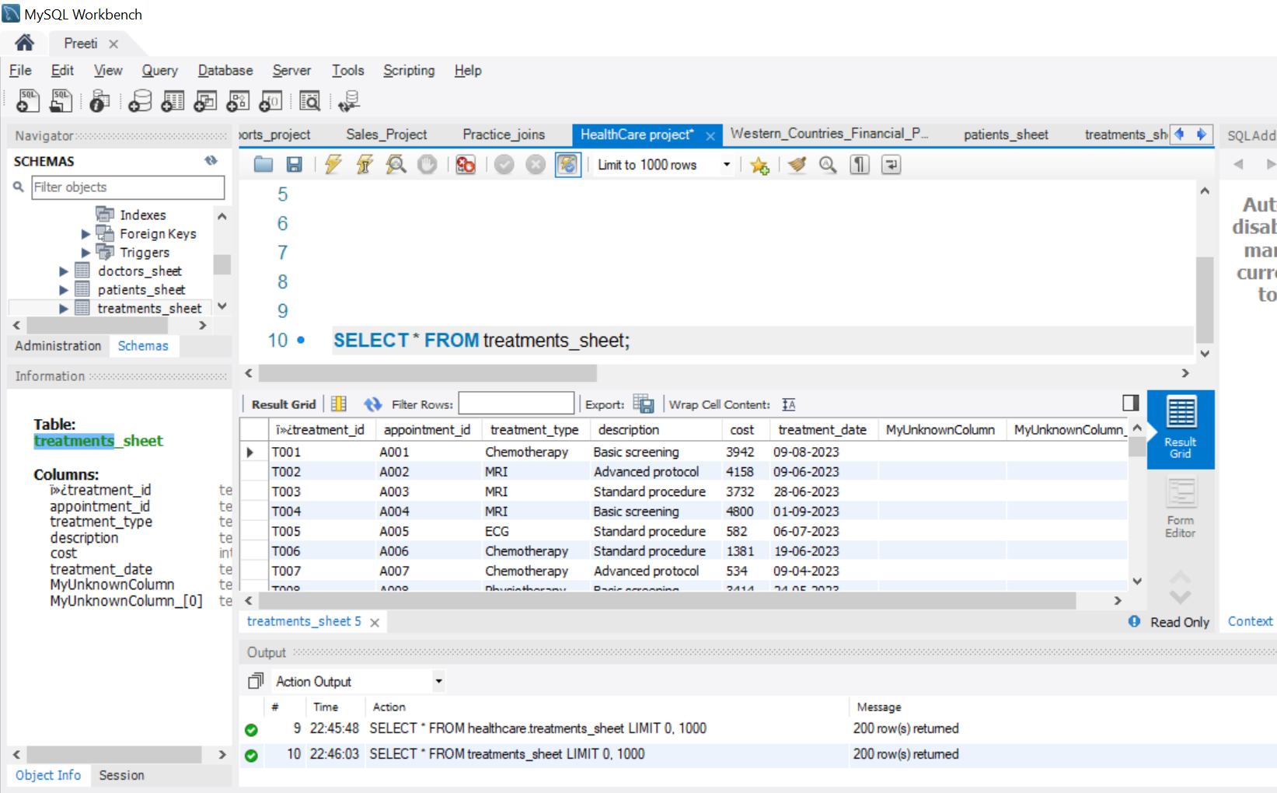

Slide 10
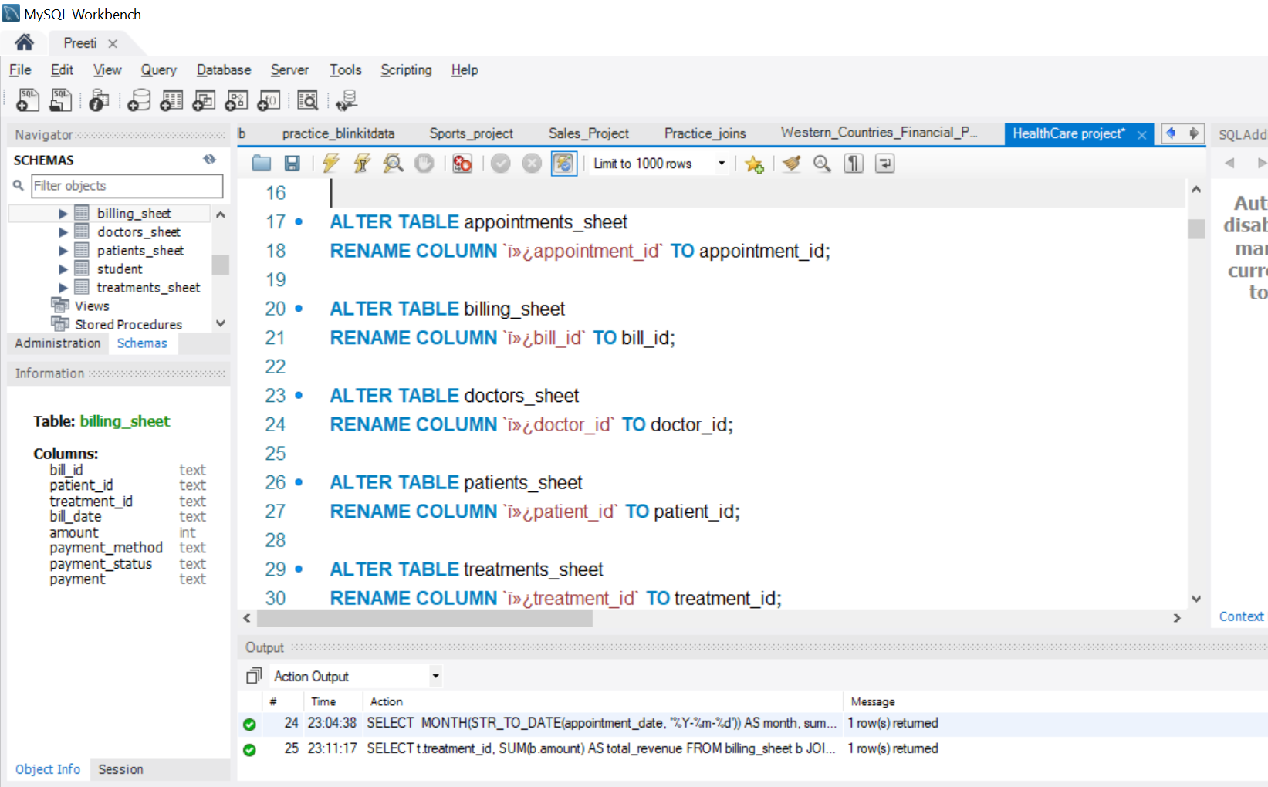

Slide 11
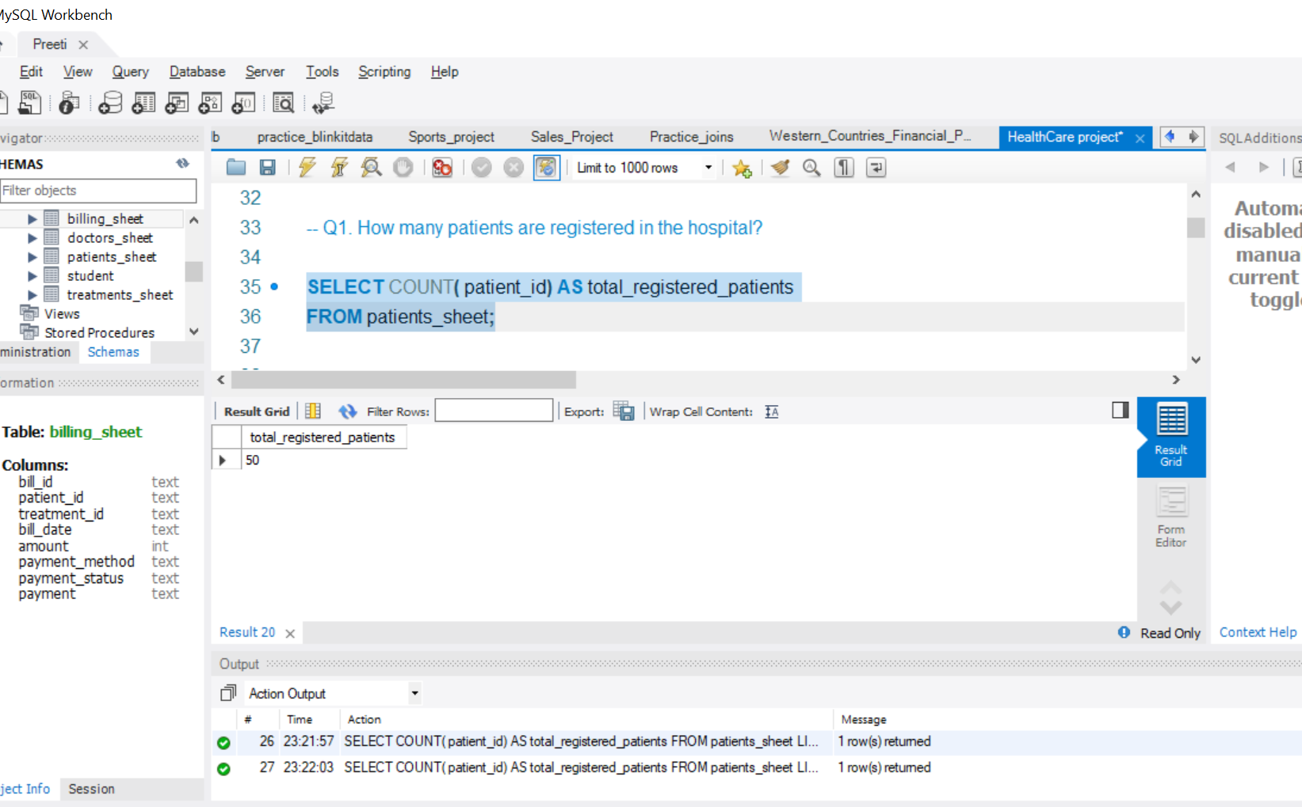

Slide 12
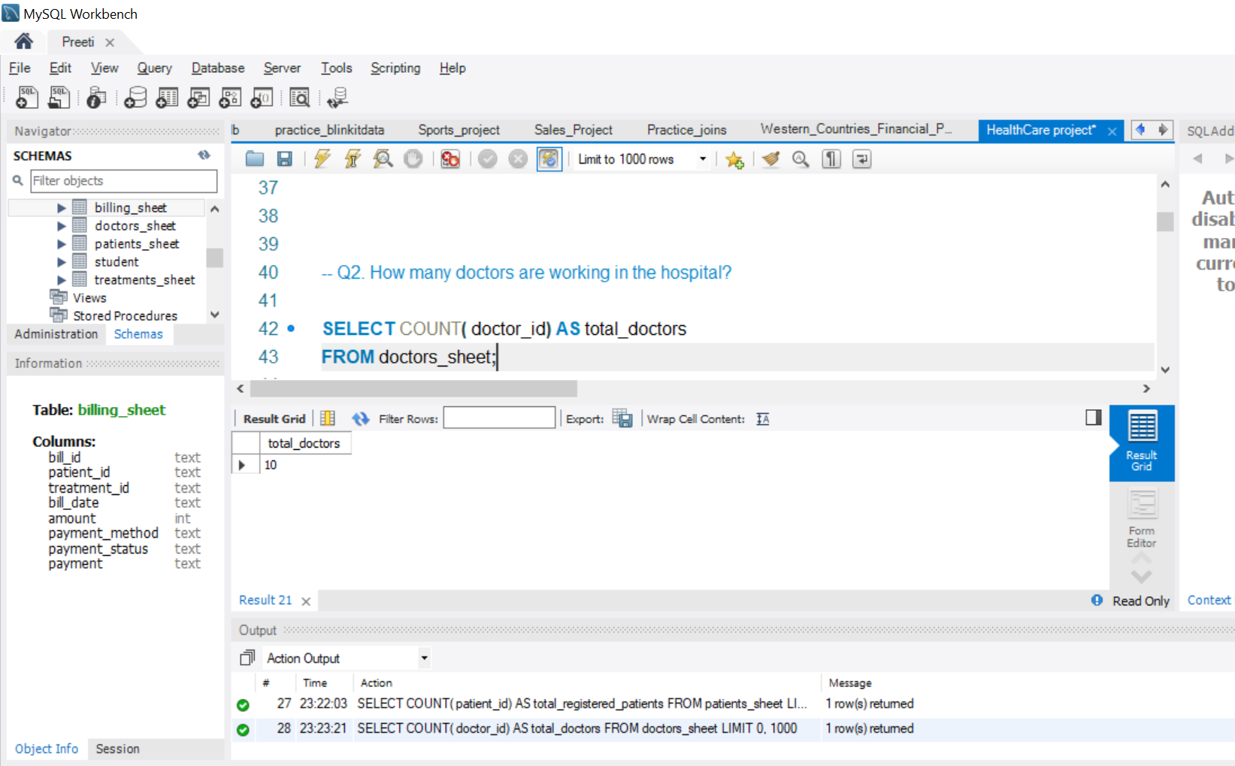

Slide 13
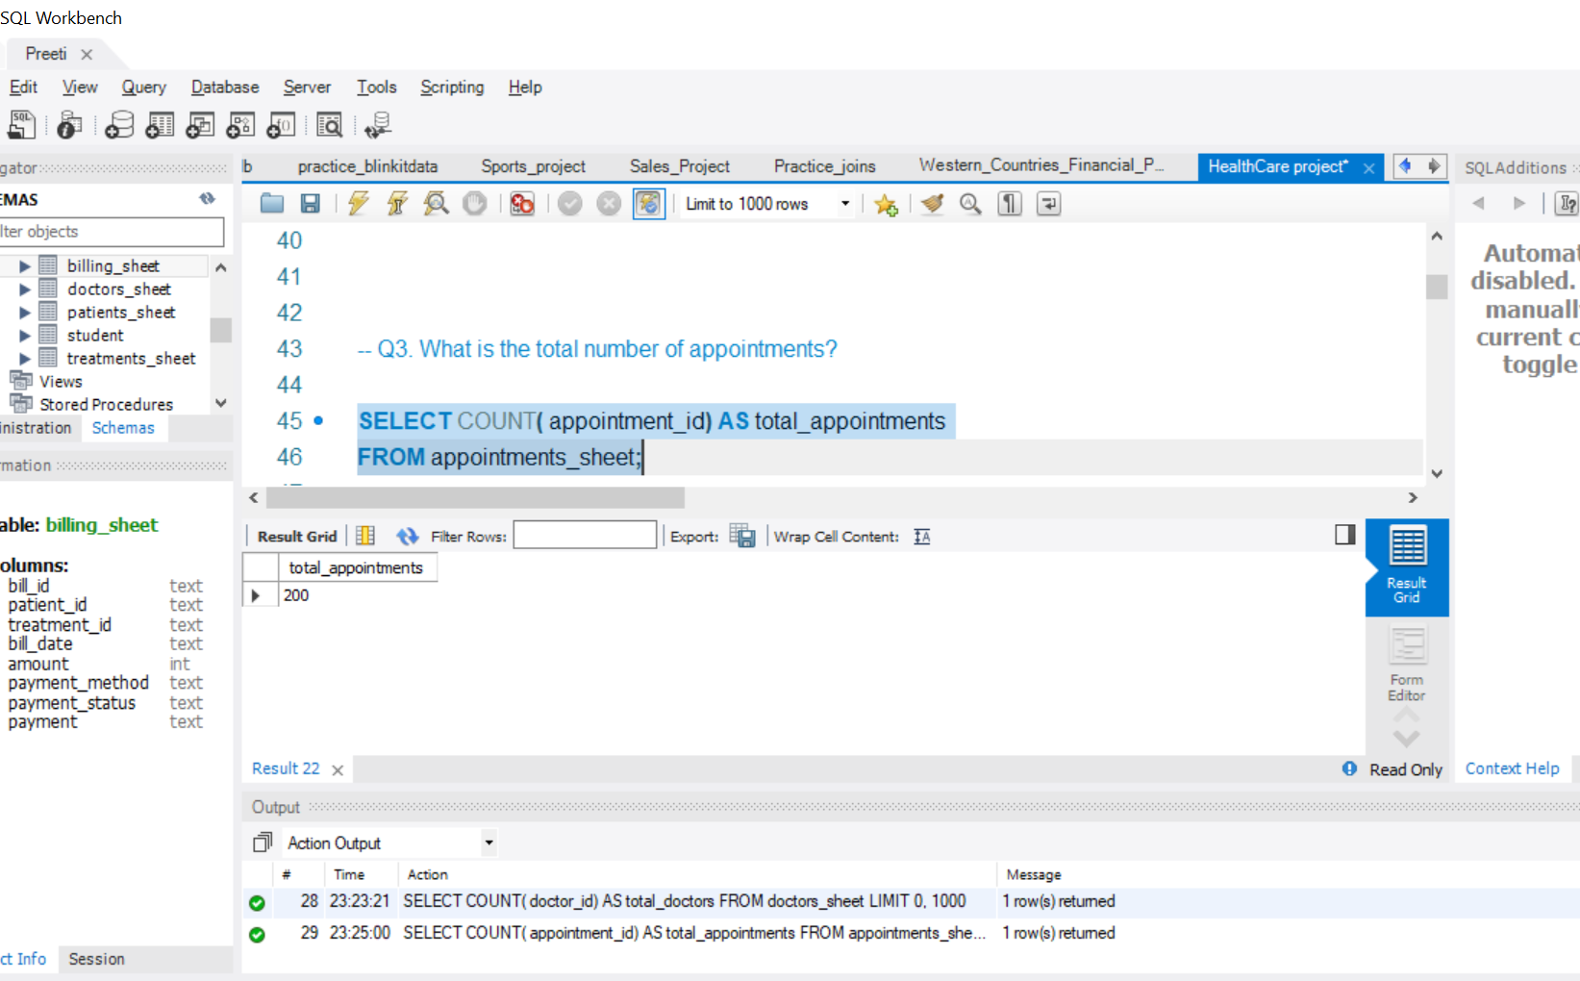

Slide 14
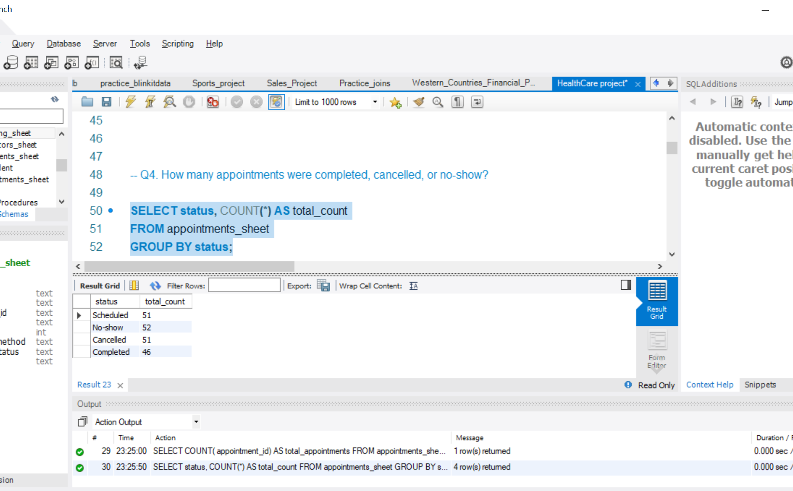

Slide 15
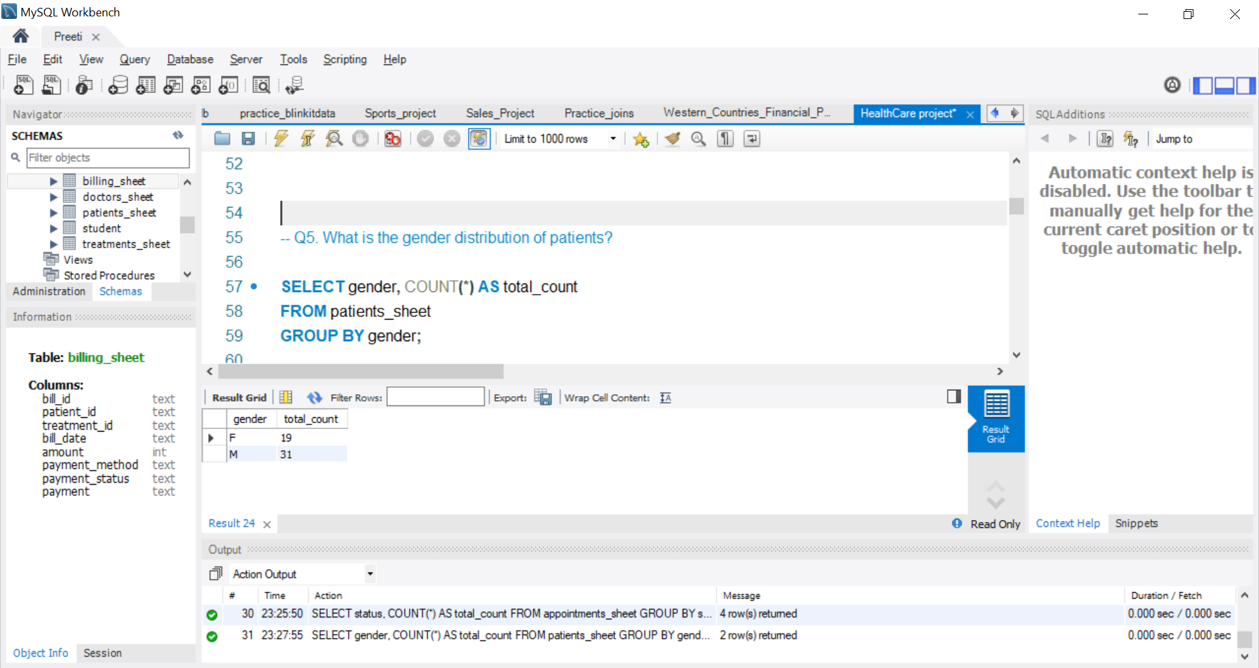

Slide 16
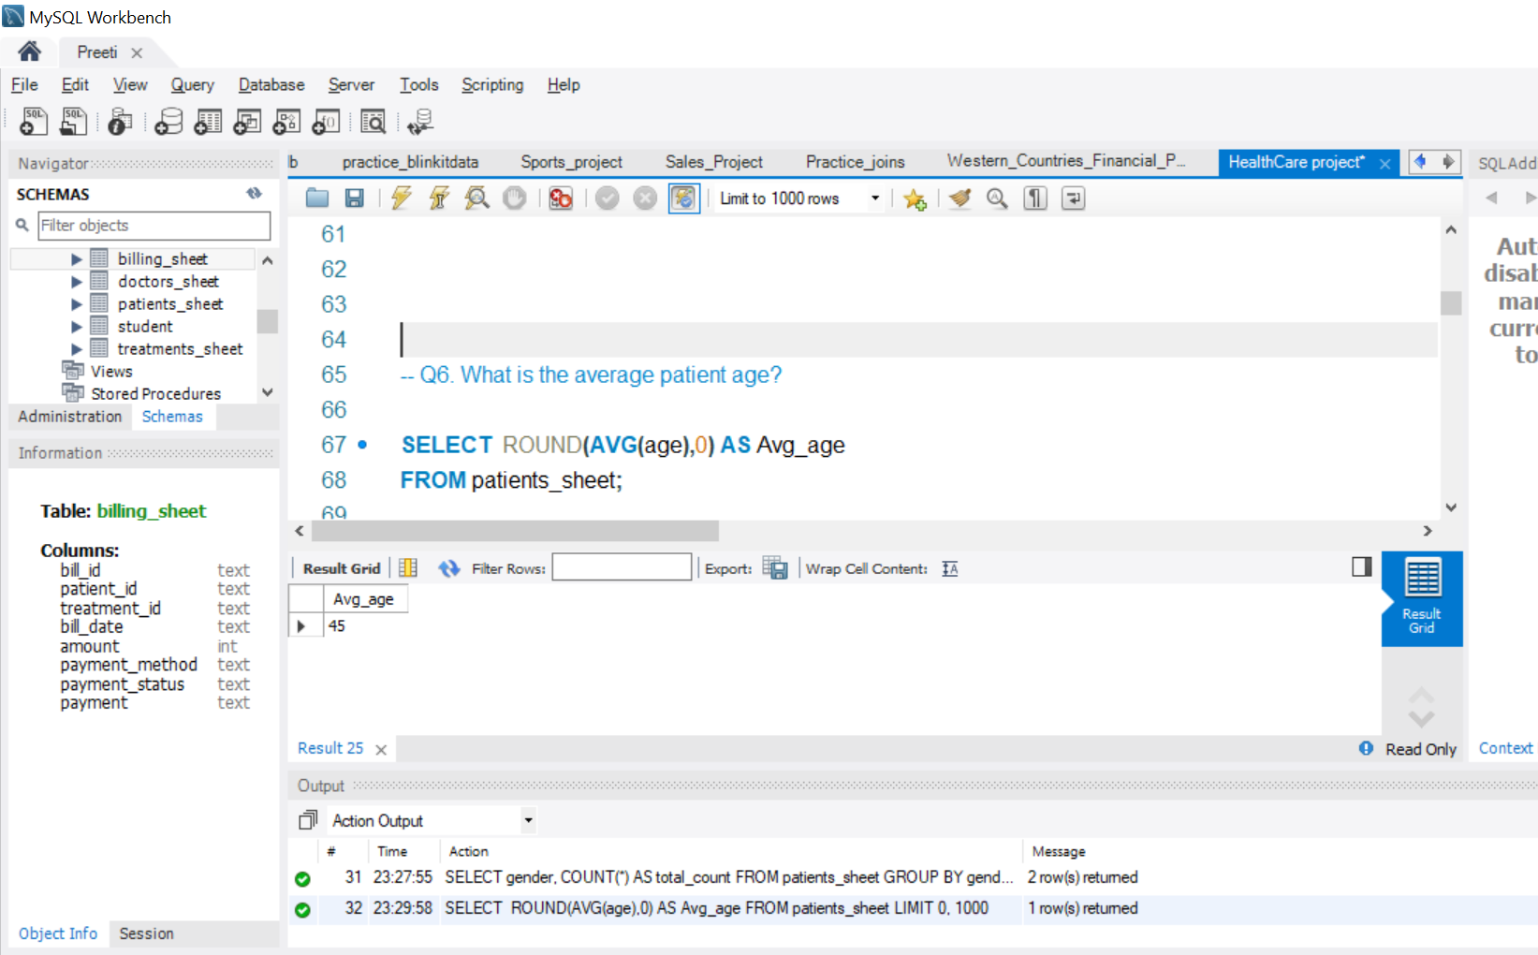

Slide 17
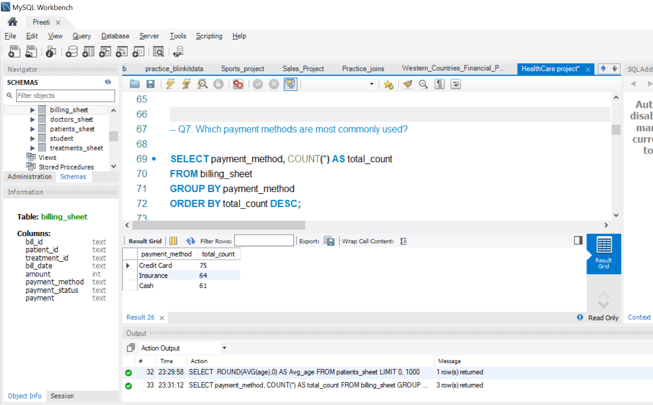

Slide 18
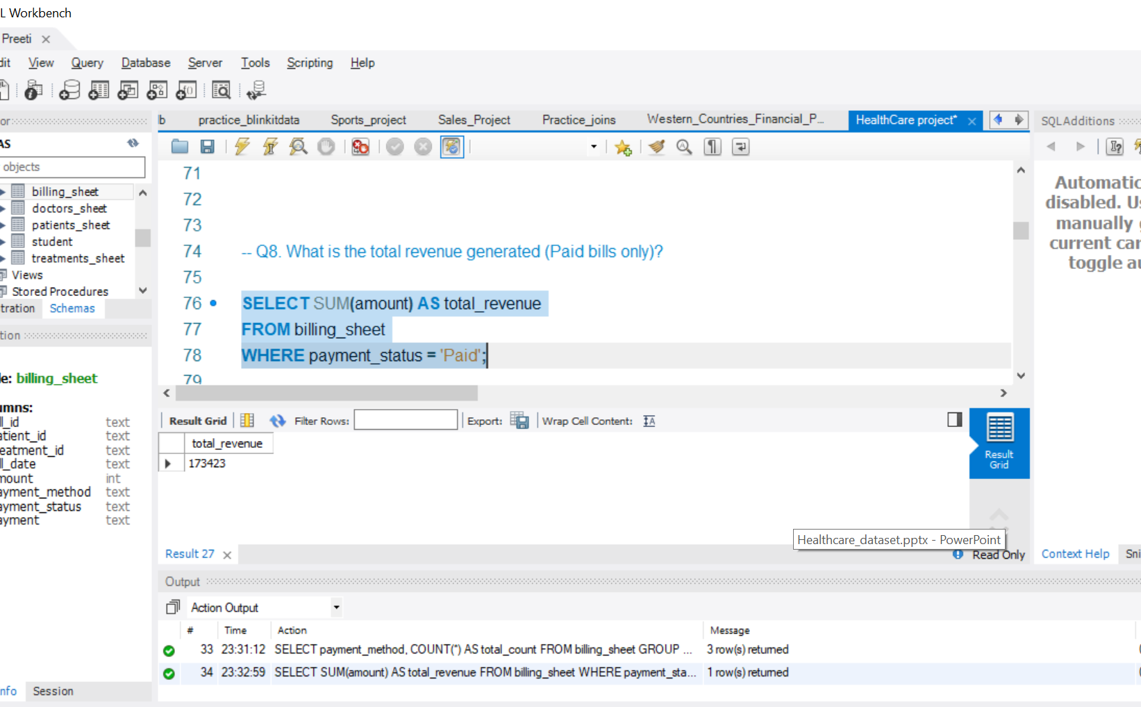

Slide 19
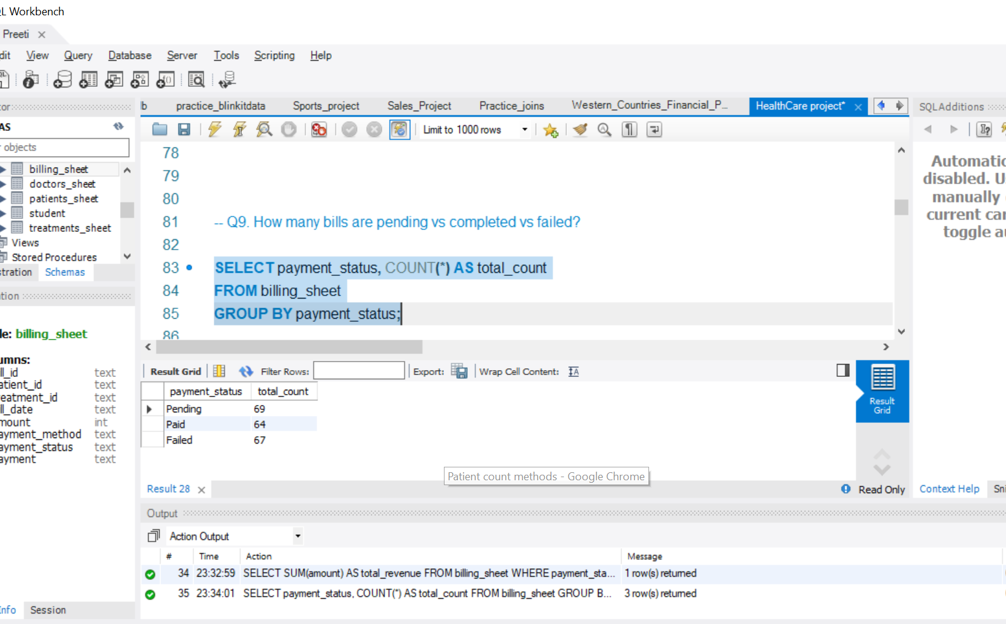

Slide 20
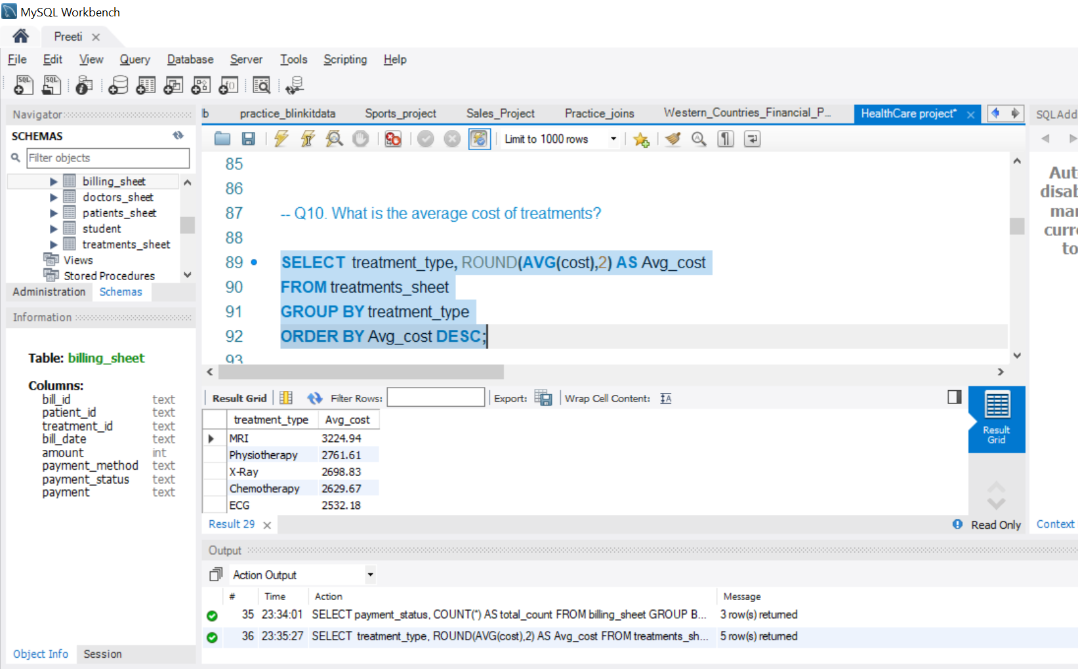

Slide 21
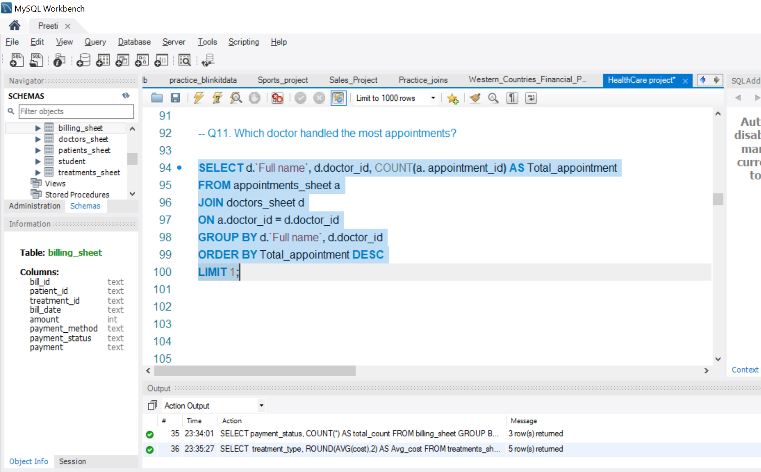

Slide 22
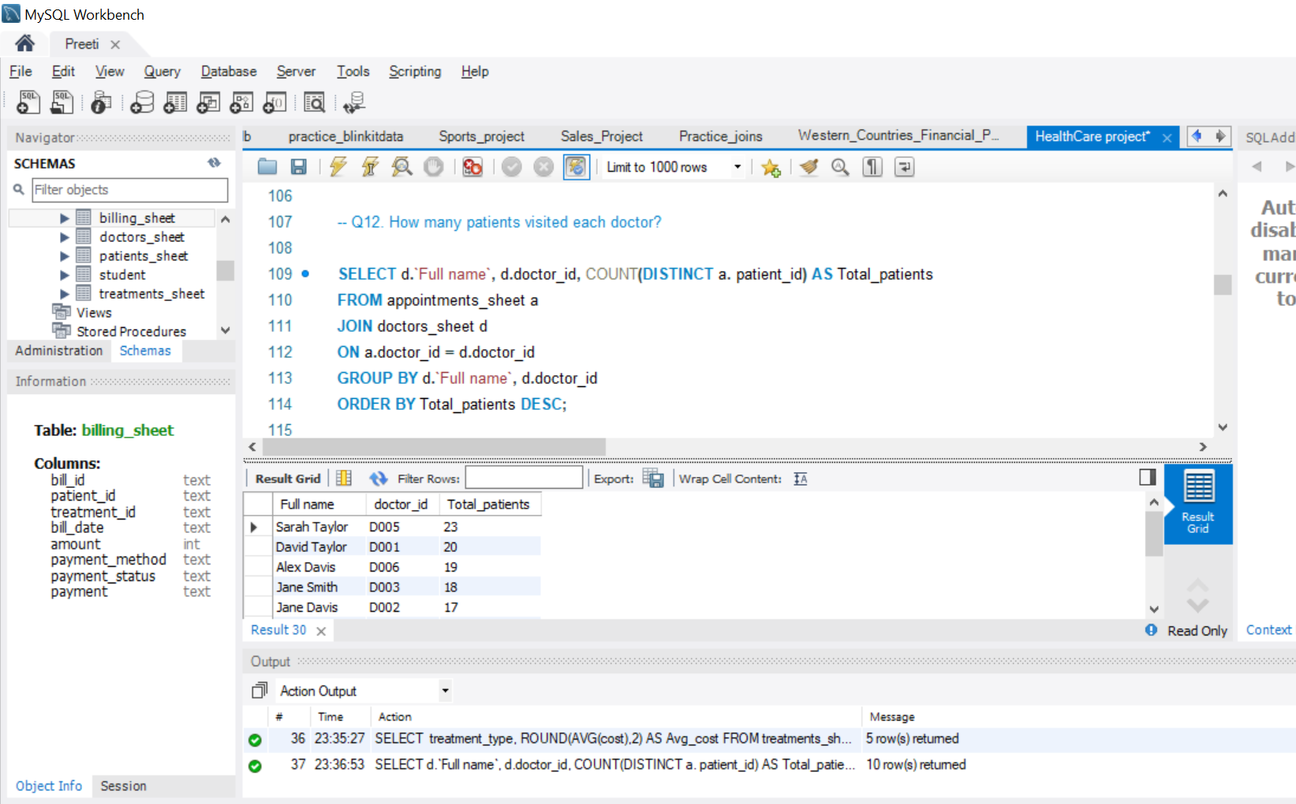

Slide 23
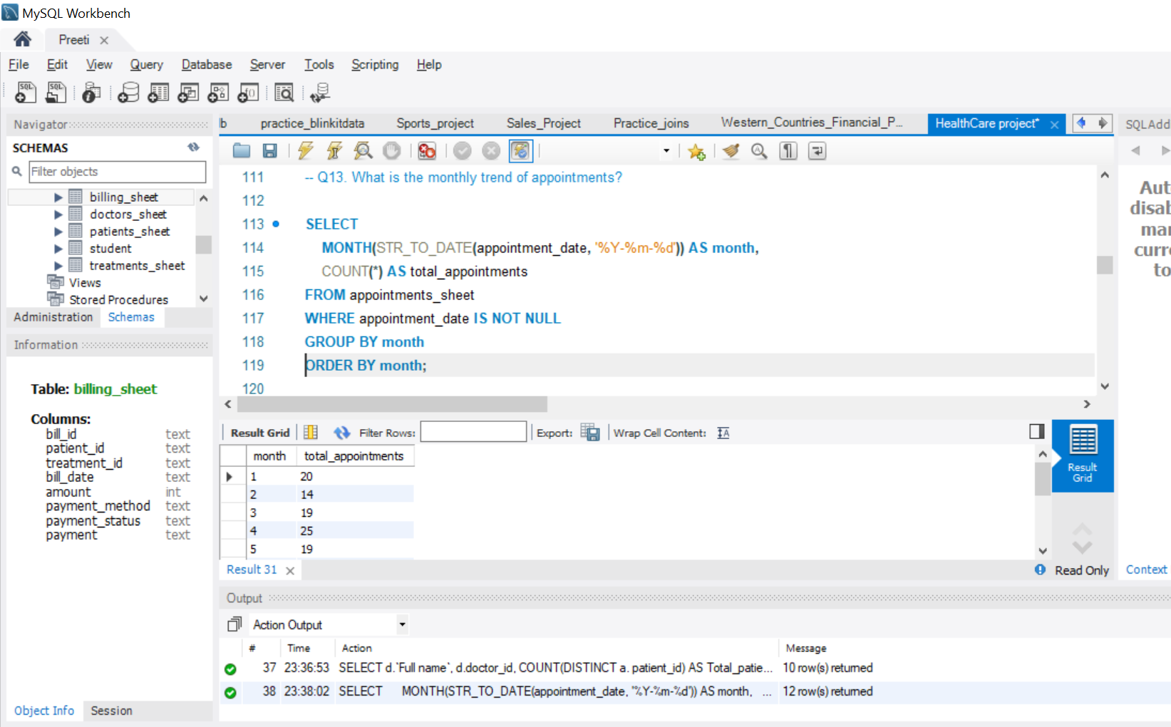

Slide 24
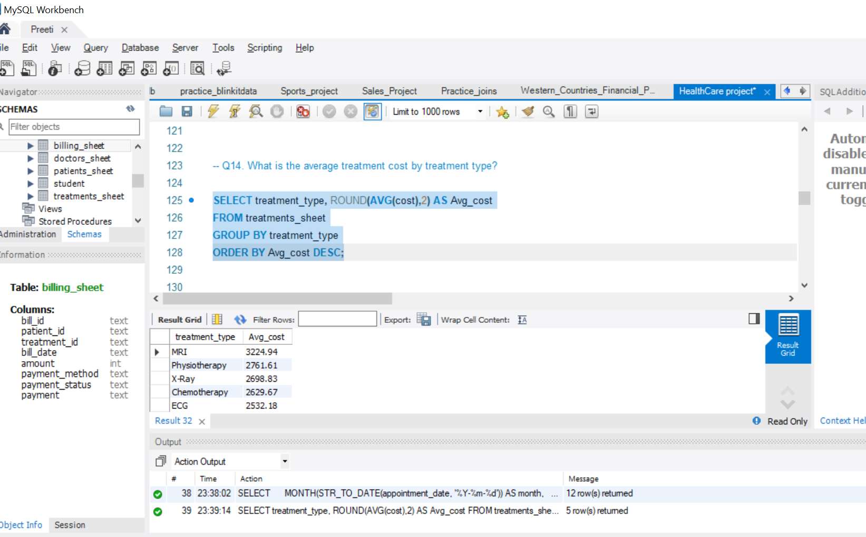

Slide 25
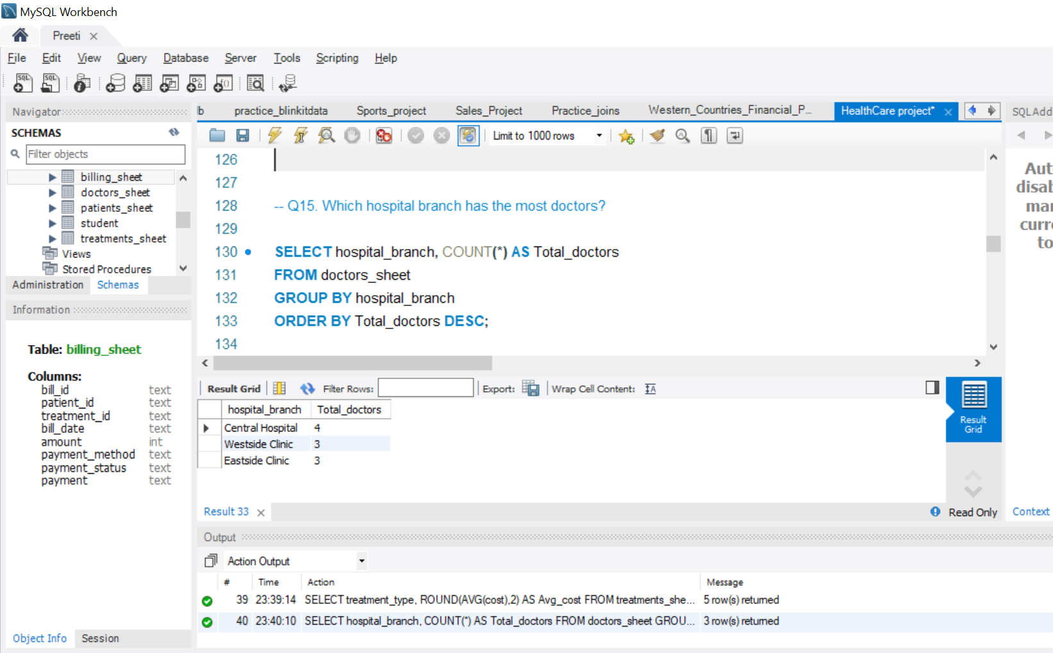

Slide 26
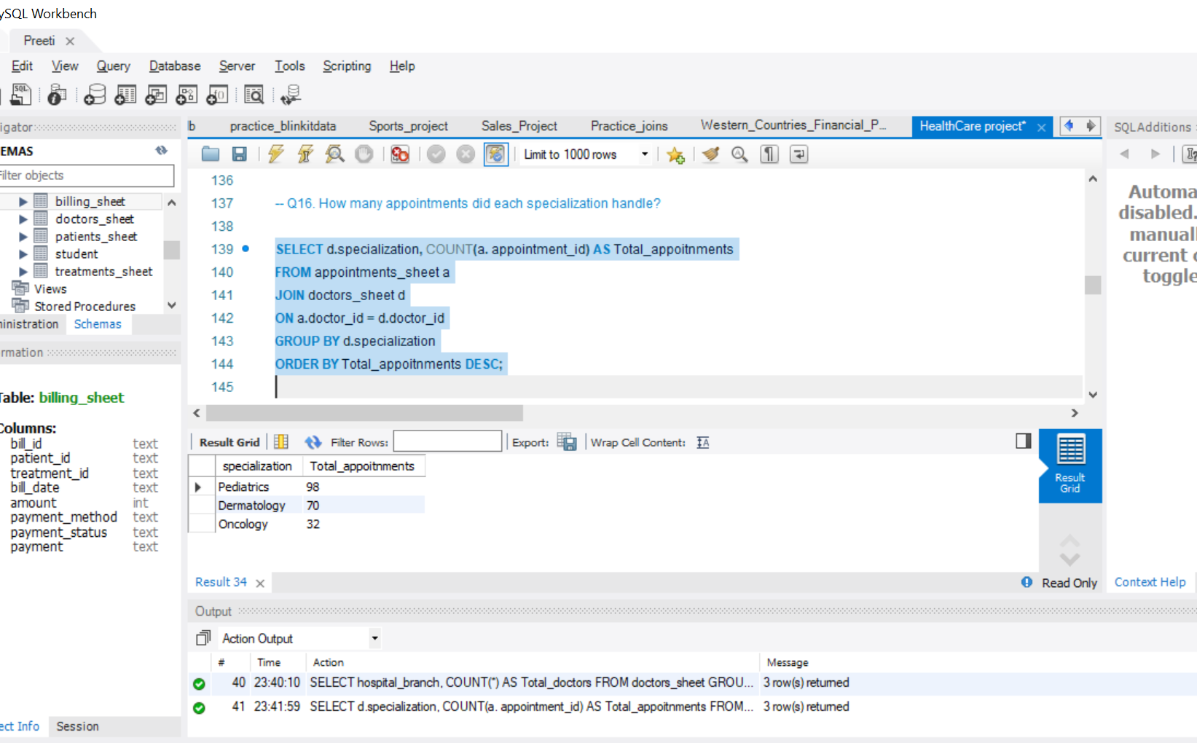

Slide 27
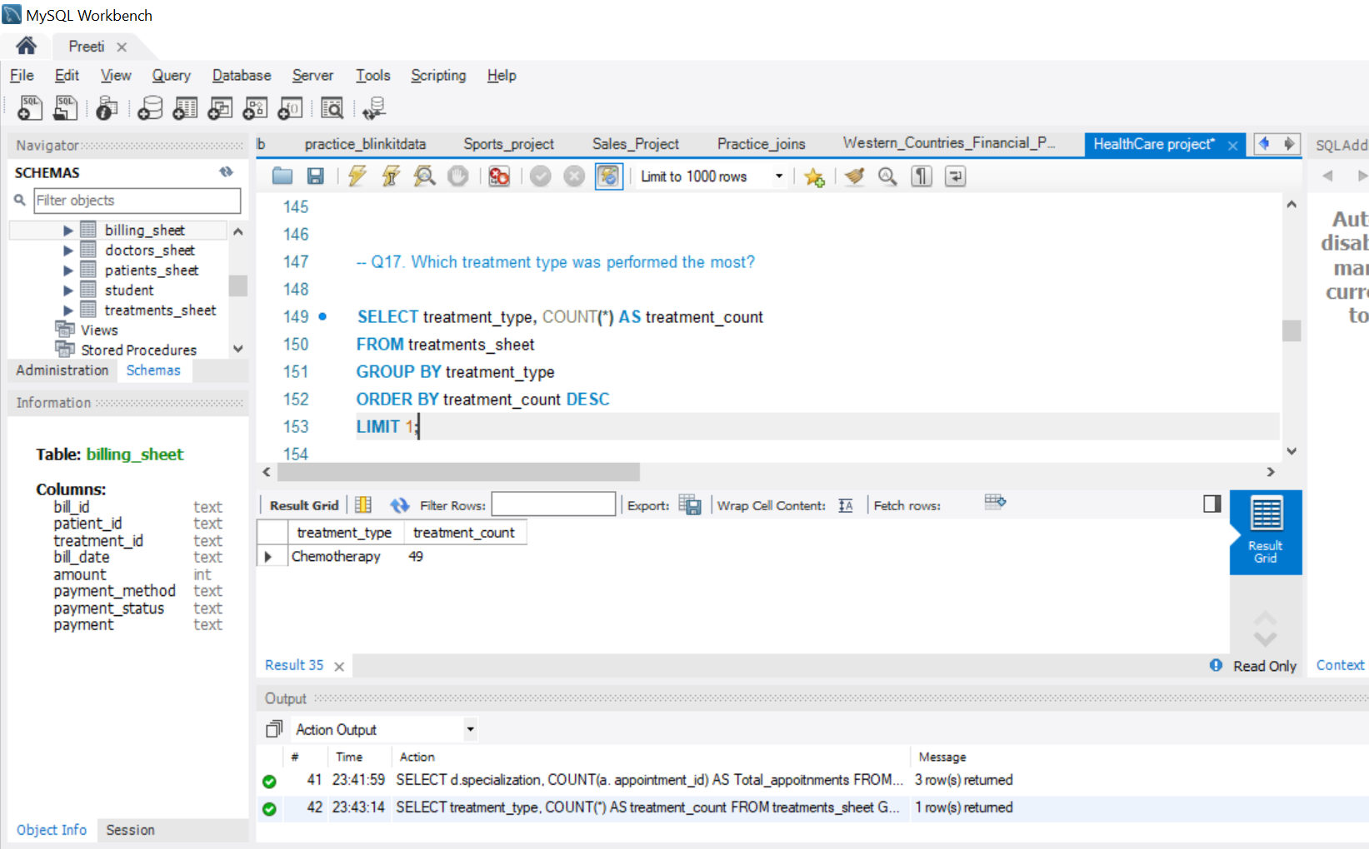

Slide 28
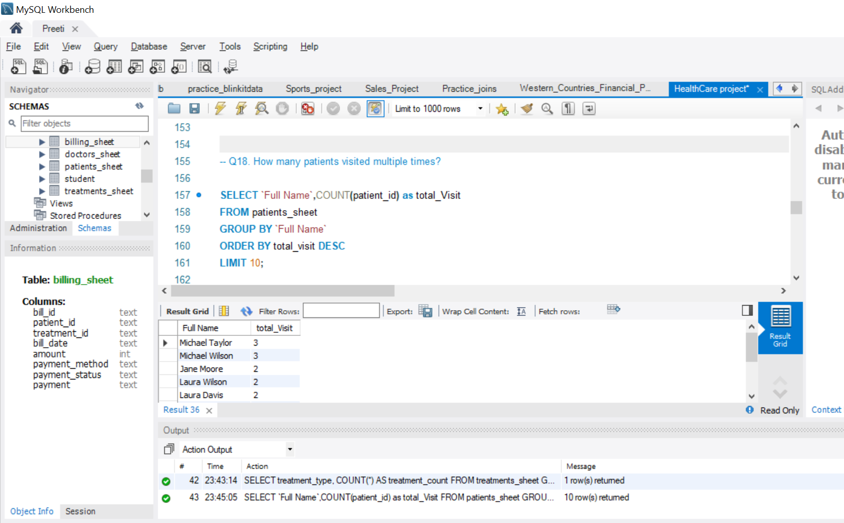

Slide 29
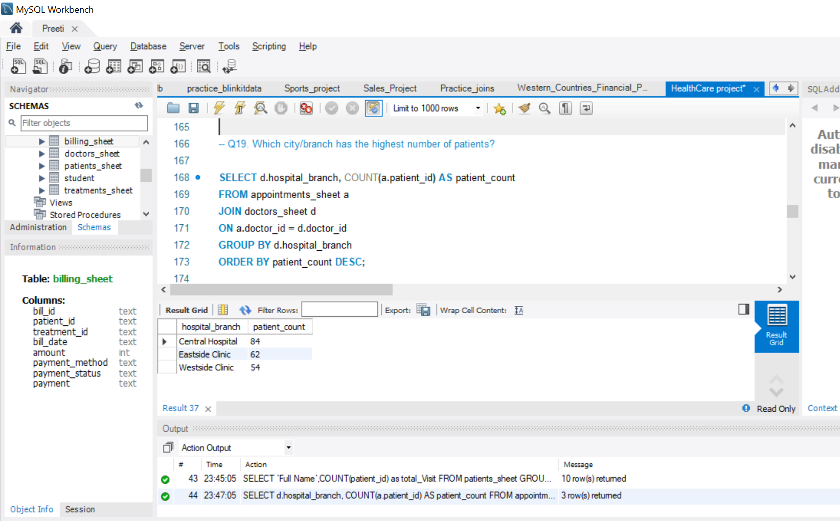

Slide 30


Slide 31
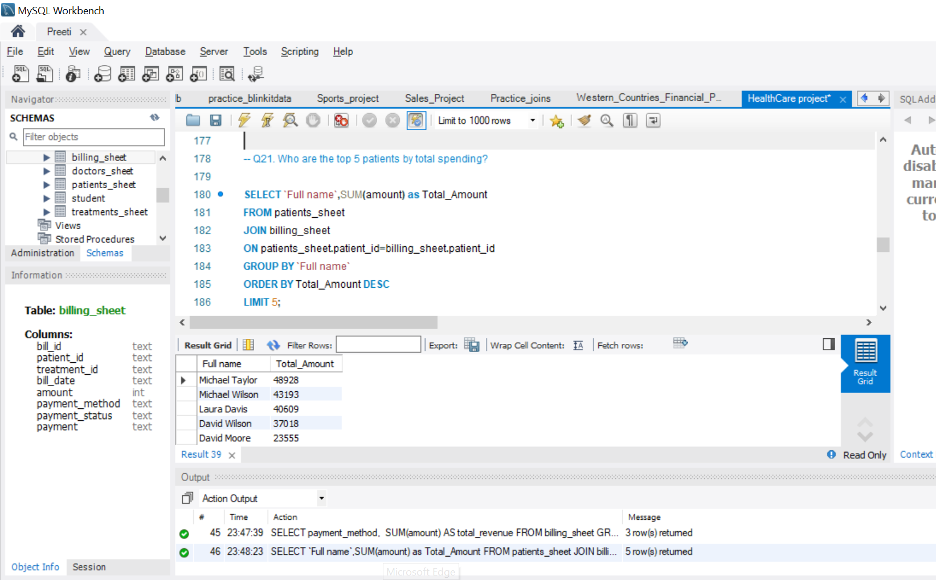

Slide 32
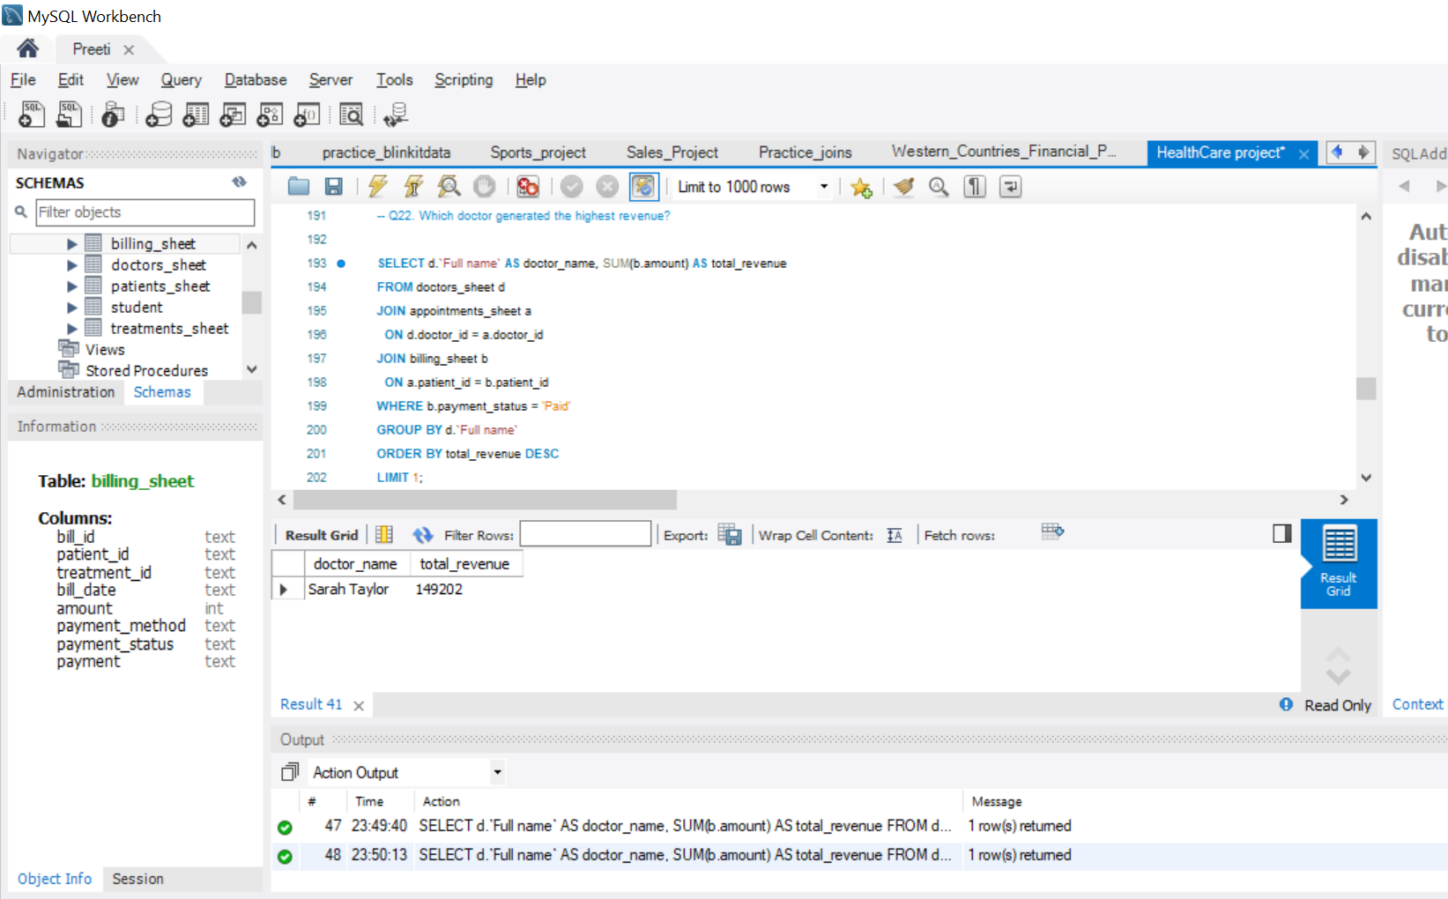

Slide 33
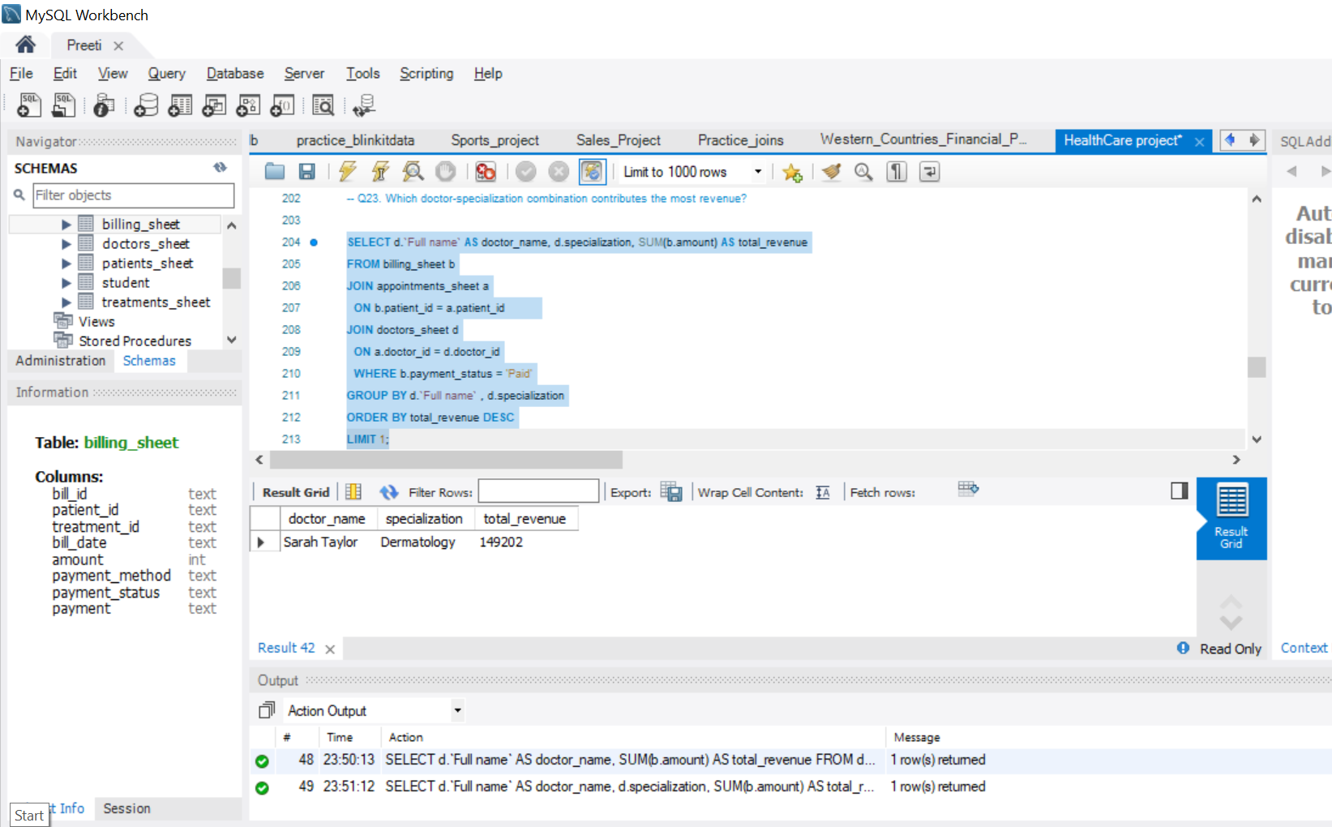

Slide 34
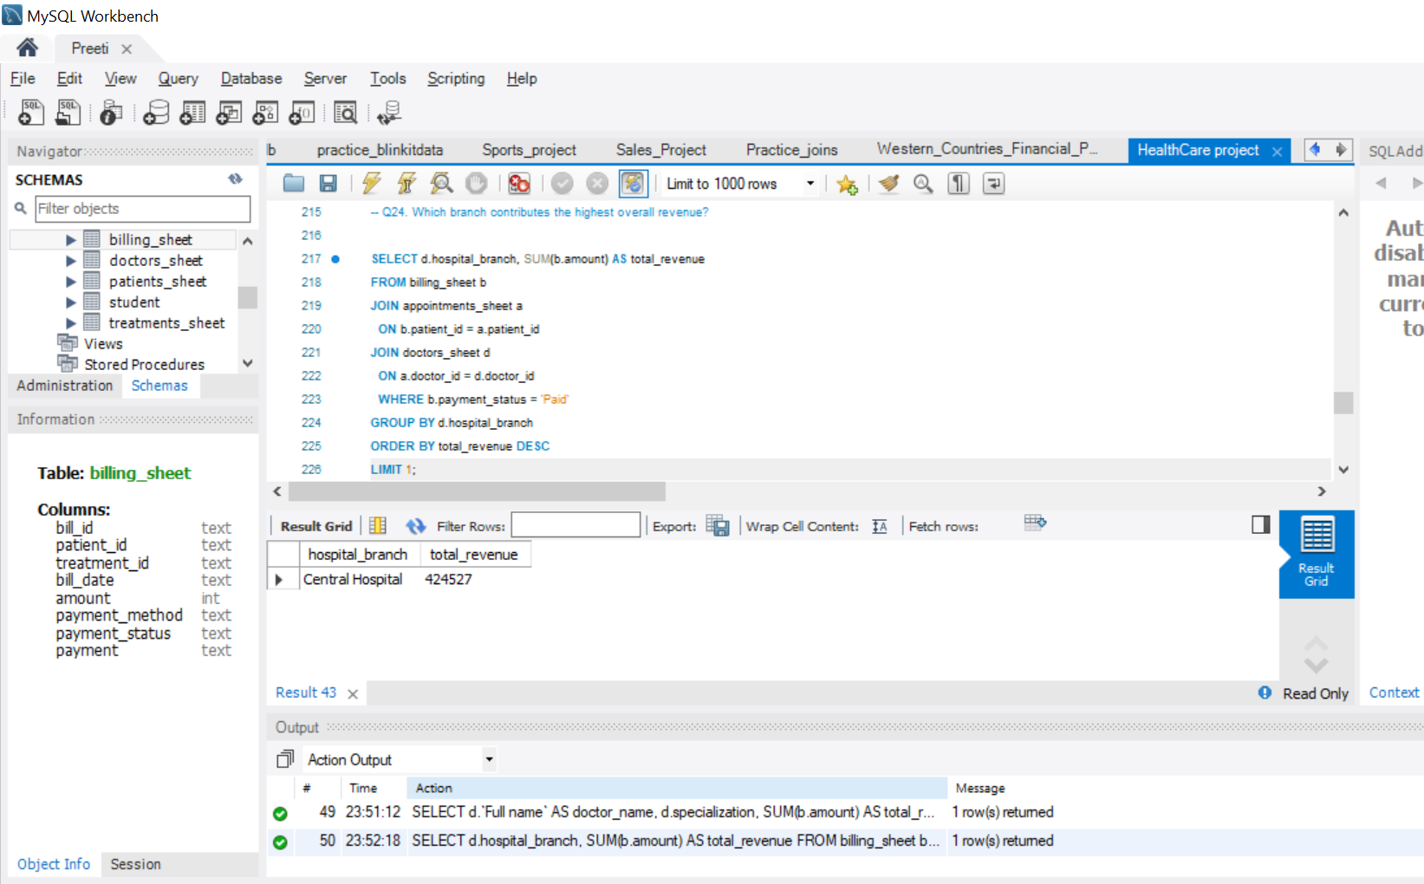

Slide 35
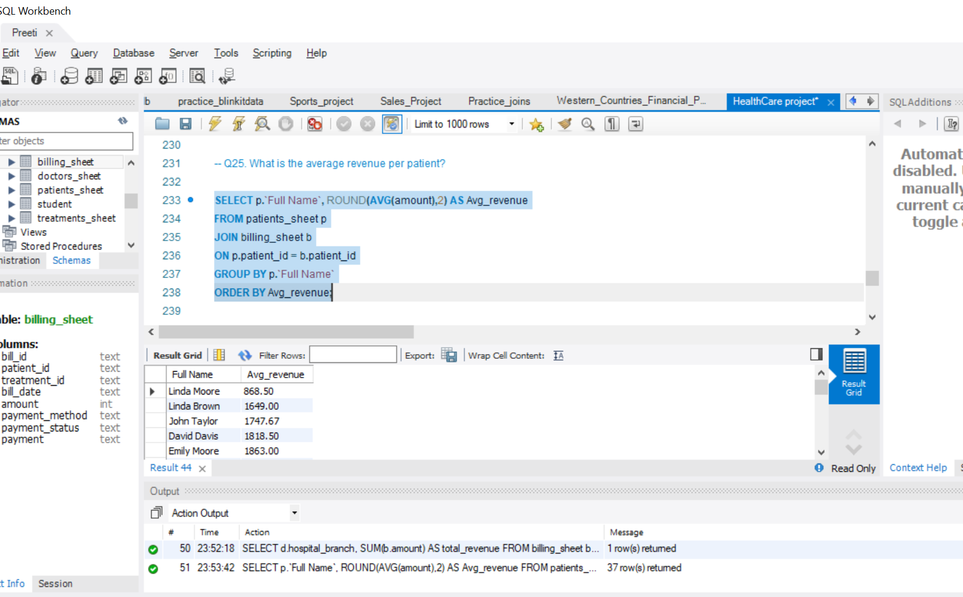

Slide 36
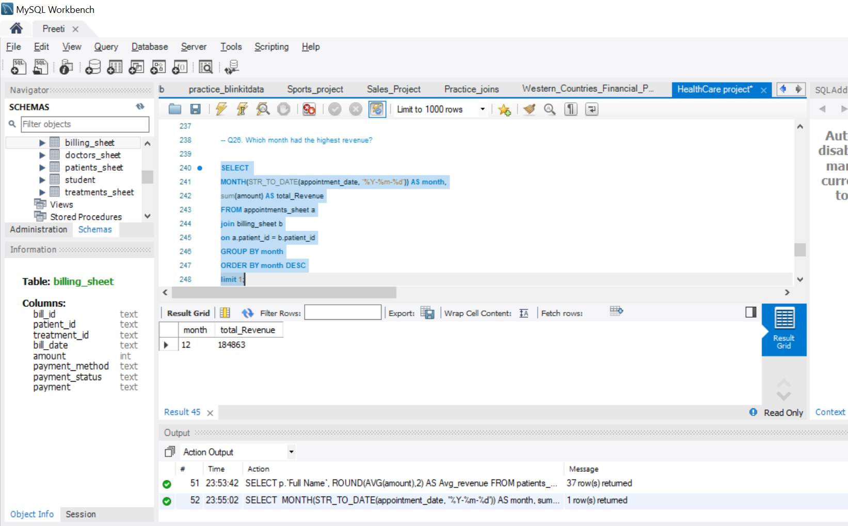

Slide 37
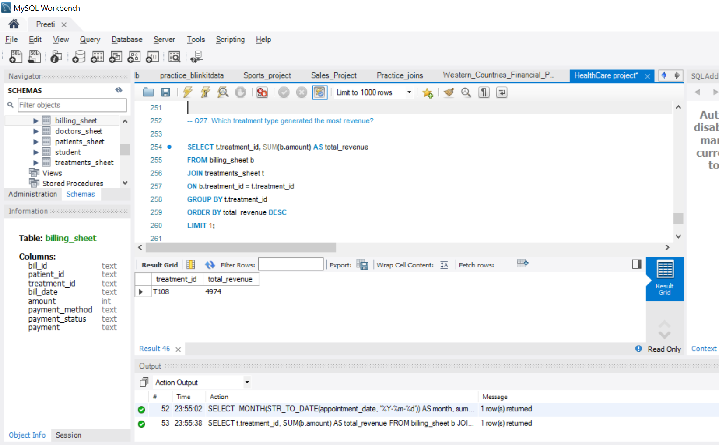

Slide 38
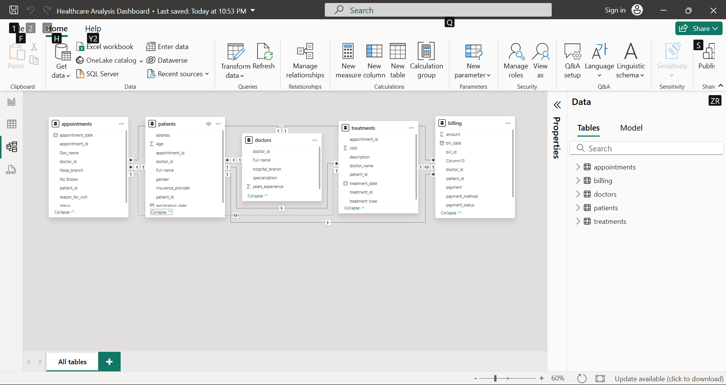
Import the Data into PowerBI ,verify if the data is properly imported or not.

Slide 39
Create a Visually pleasing Dashboard report by following the rules of making the Dashboard.

Slide 40
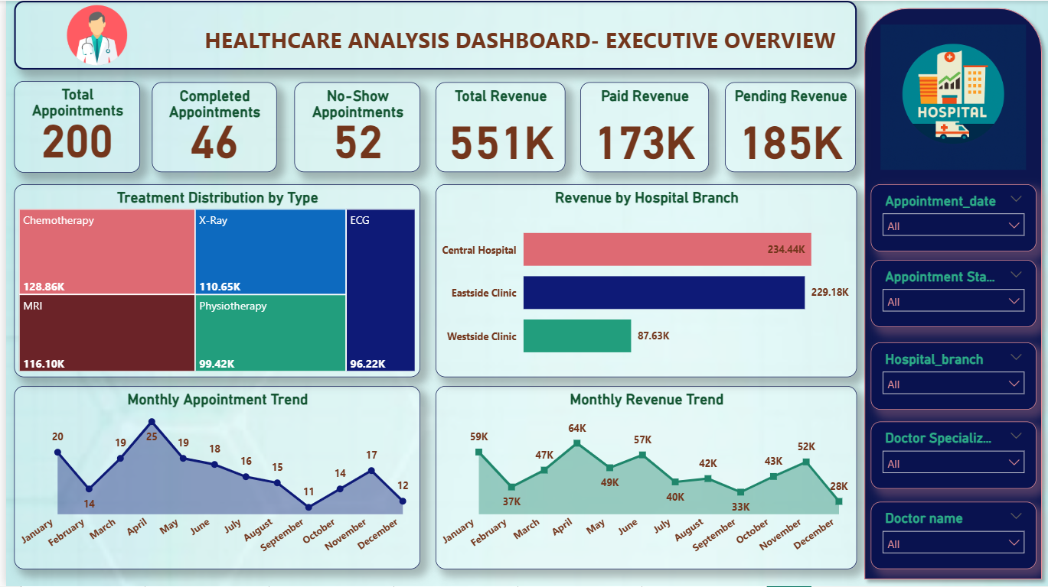

Slide 41
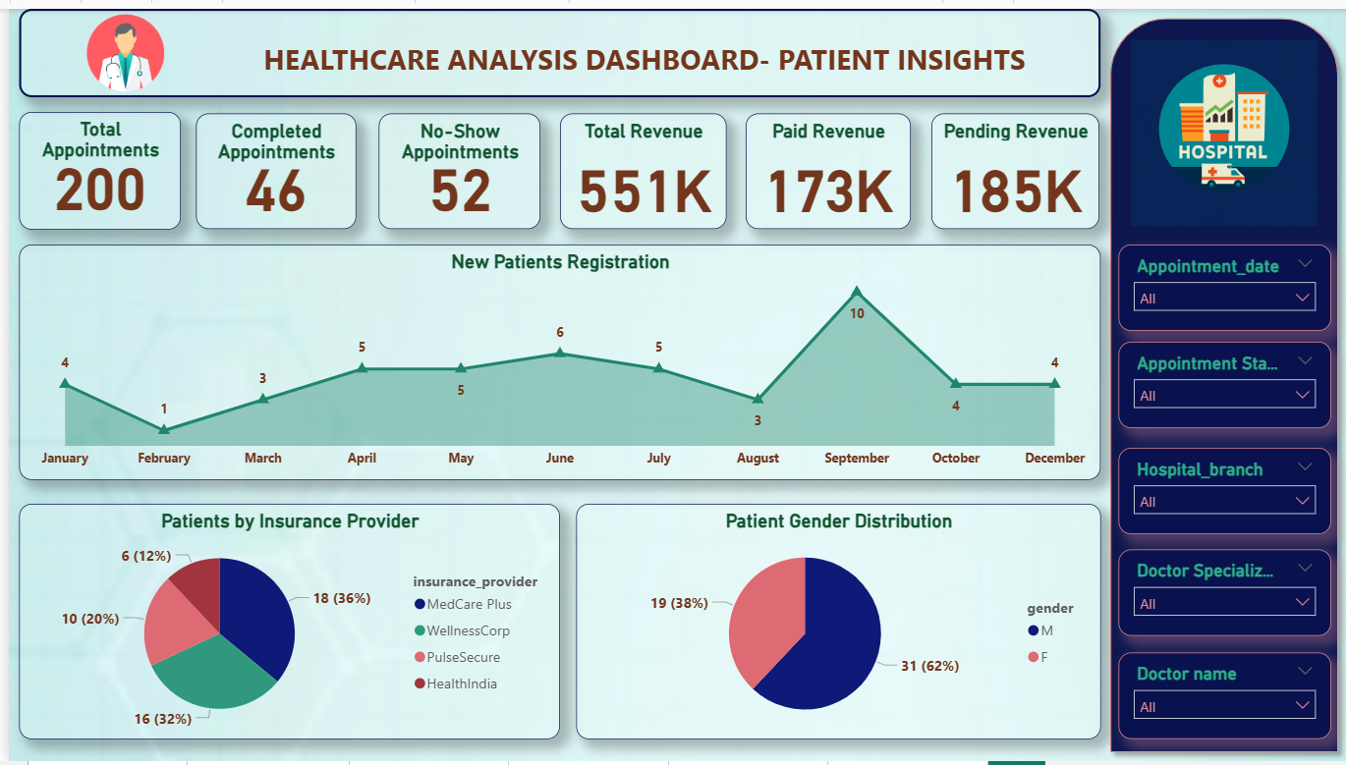

Slide 42
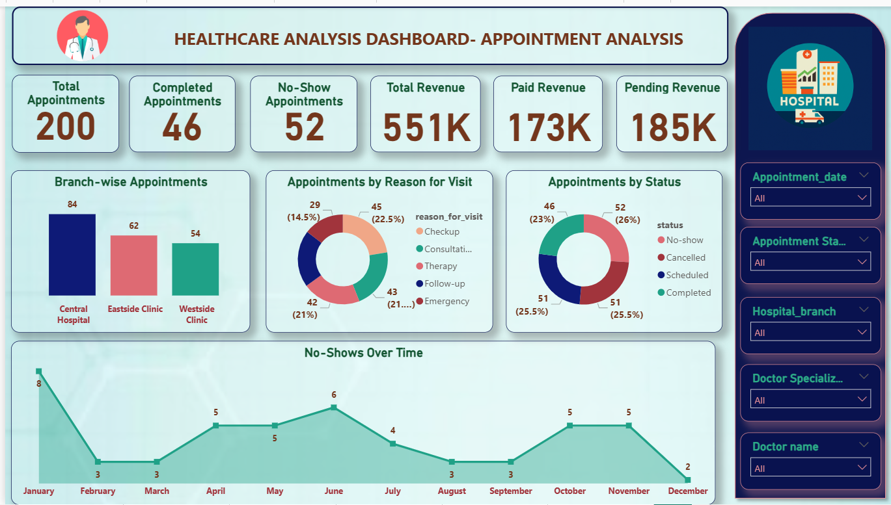

Slide 43
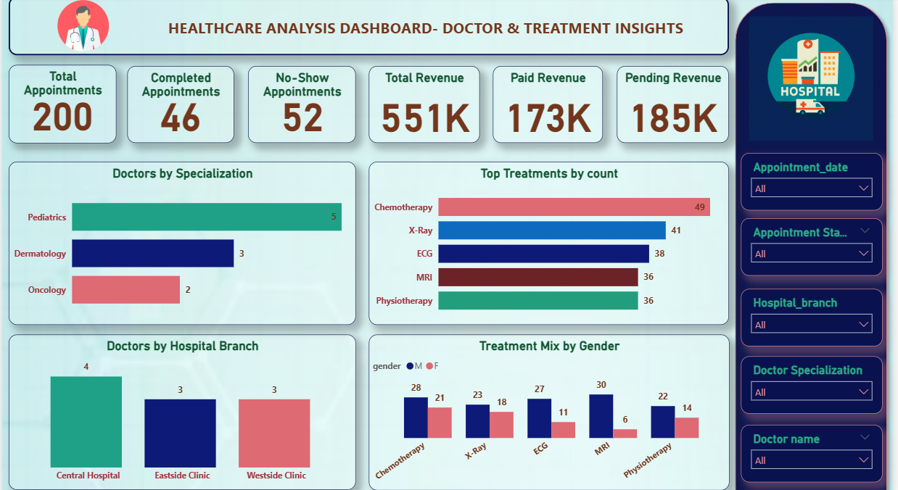

Slide 44
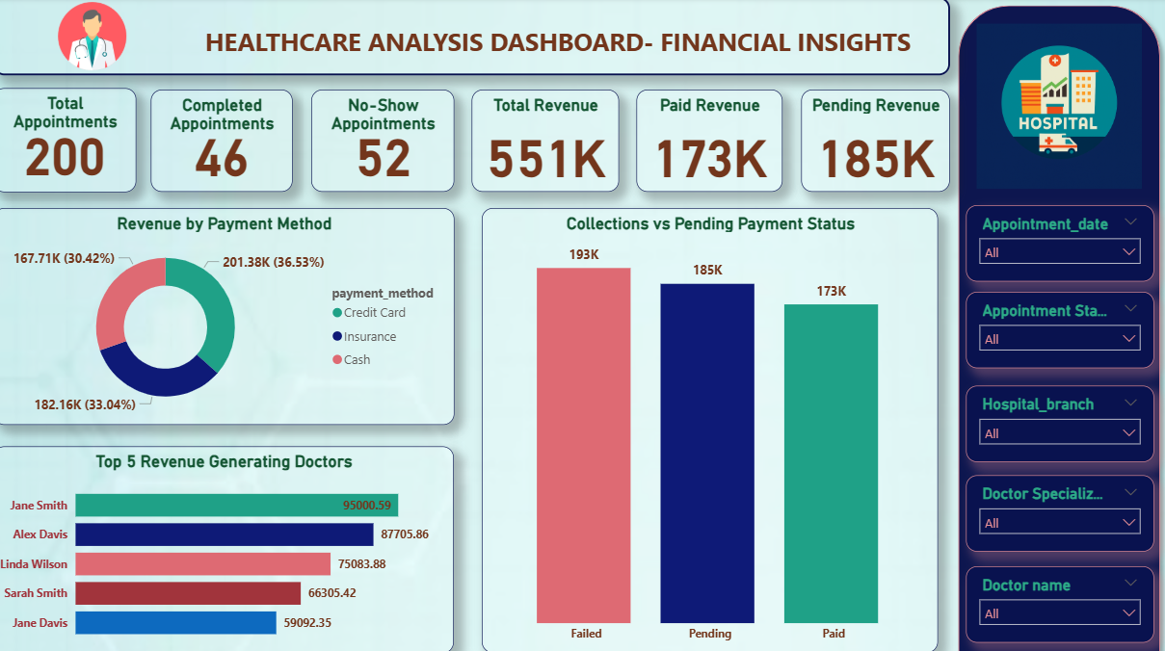

Slide 45
Derive Conclusion and Inferences from the Dashboard.

Slide 46
📌 Conclusions & Inferences
Appointments are not effective
Out of 200 appointments, only 46 were completed.
Around 52 patients did not show up → this means time and resources are wasted.
Revenue is at risk
Hospital generated 551K in revenue, but only 173K was collected.
185K is still pending → this is a cash flow problem for the hospital.
Branch performance is uneven
Central & Eastside branches are doing well, while Westside branch is underperforming.
This shows that resources or promotions may not be equally distributed.

Slide 47
4. Doctors & services make a big difference
Certain doctors and treatments (like chemotherapy & imaging) bring more revenue than others.
Recognizing and supporting top performers can help increase hospital income.
5. Seasonal demand exists
September and May had the highest appointments.
Hospital needs to plan staff and resources in advance for these busy months.
✅ Overall Inference
The hospital is losing money due to no-shows and pending payments. If they can remind patients, collect payments faster, and promote weaker branches, overall performance will improve.

